Slide 1
IN THE HOUSE

Slide 2
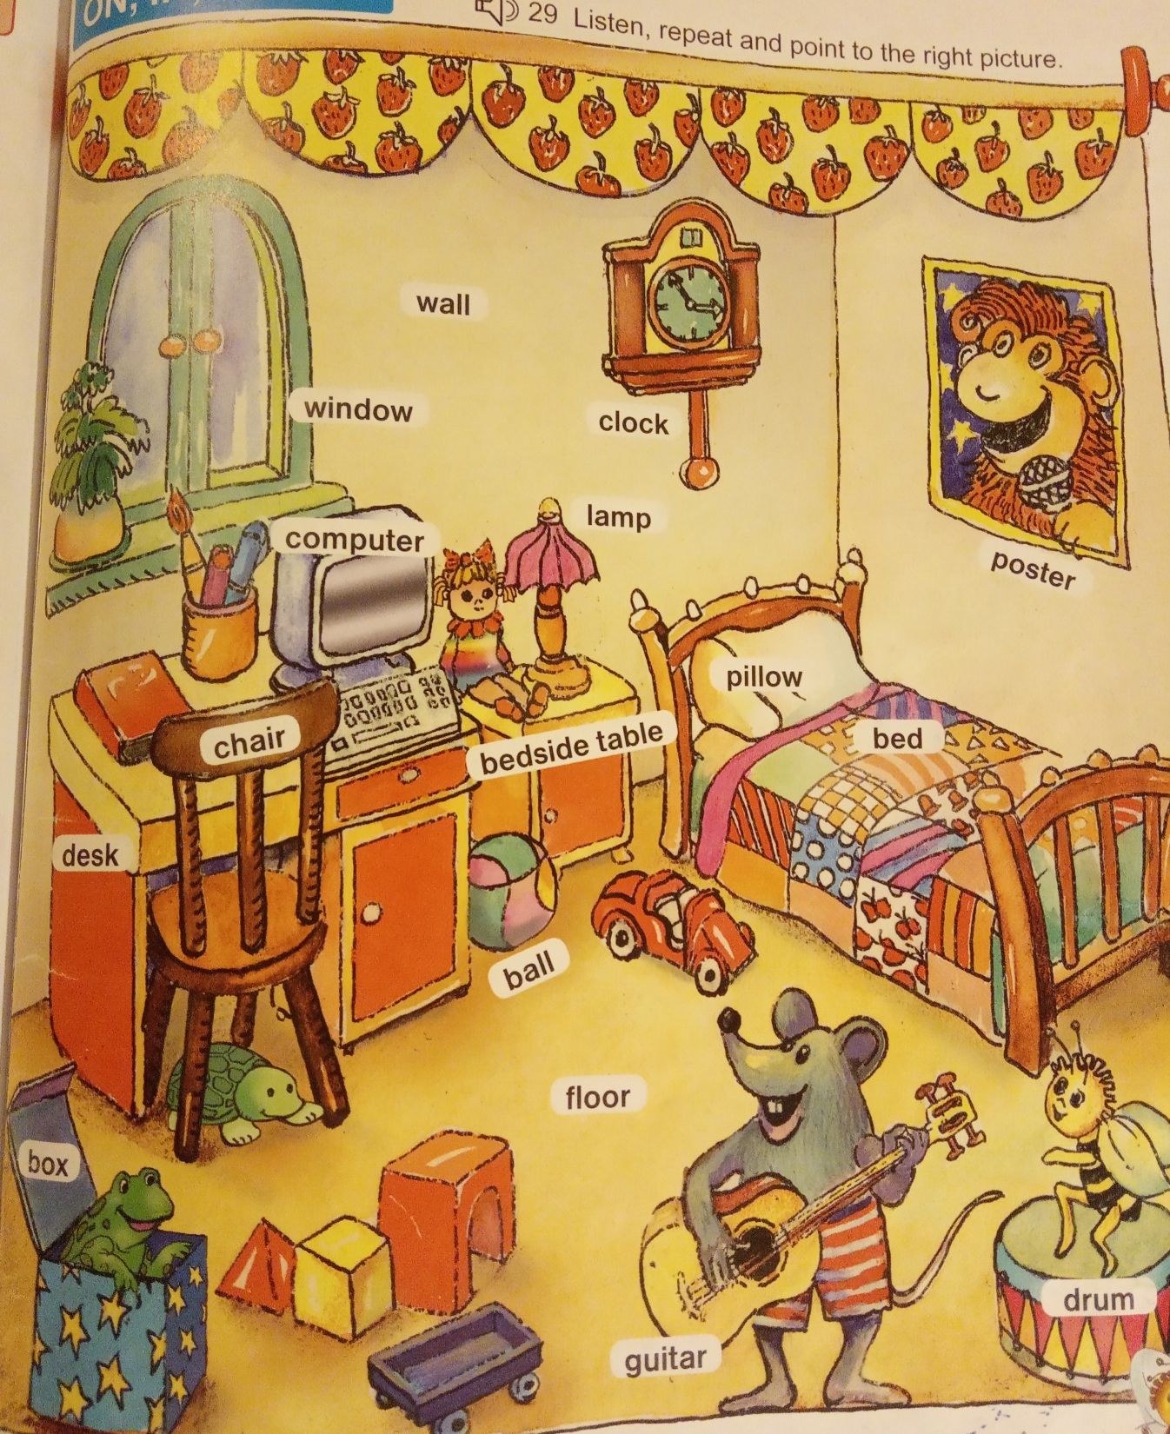
OPAKUJ SI
NAHLAS
SLOVÍČKA
Z TVOJHO
CD č. 29
A UKÁŽ, KDE SA PREDMET NACHÁDZA.

Slide 3
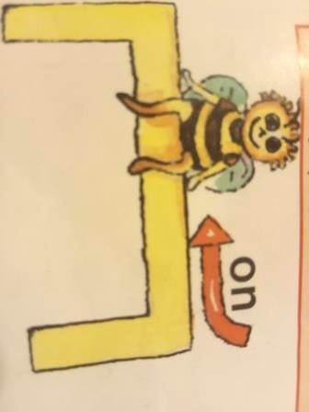
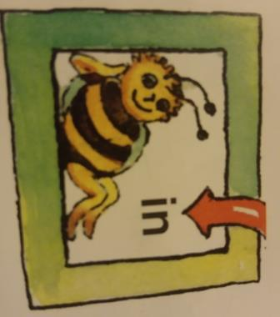
ON
IN
UNDER
NA
V
POD

Slide 4
I can see a frog. It is ...... the box.
?
I can see a frog. It is in the box.
in

Slide 5
I can see a car. It is on the floor.
I can see a car. It is ...... the floor.
?
on

Slide 6
?
I can see a turtle. It is under the chair.
I can see a turtle. It is ...... the chair.
under

Slide 7
?
I can see a poster. It is ...... the wall.
I can see a poster. It is on the wall.
on

Slide 8
?
I can see a computer. It is on the desk.
I can see a computer . It is ...... the desk.
on

Slide 9
?
I can see a lamp. It is ...... the bedside table.
I can see a lamp. It is on the bedside table.
on

Slide 10
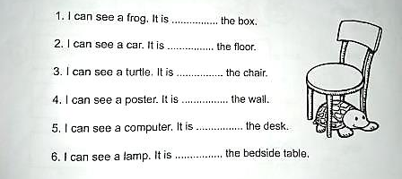
Kontrola PZ- 19/4
Fill in. Doplň predložky in, on, under podľa obrázka v učebnici na strane 33 ☺
in
on
under
on
on
on

Slide 11
https://www.youtube.com/watch?v=PAnXF3CYqgM https://www.youtube.com/watch?v=R9intHqlzhc Možno chceš vedieť viac ... Tieto slovíčka ťa určite nebudem skúšať na známku ☺ https://www.youtube.com/watch?v=m27Cck_LGHc
AK MÁŠ ČAS, ZOPAKUJ SI SLOVÍČKA ☺

Slide 12
ZDROJE:
UČEBNICA A PRACOVNÝ ZOŠIT BUSE BEE 2
INTERNET - mix

